Slide 1
Overview and Descriptive Statistics
Session 01 - 02
Anom Yudistira

Slide 2
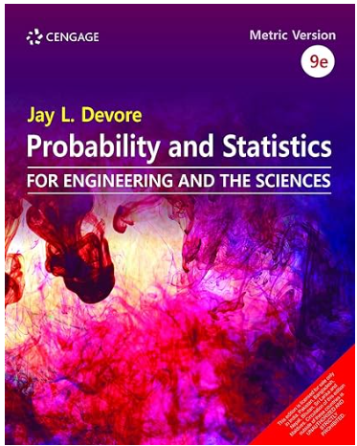
Jay L. Devore. (2020). Probability and Statistics for Engineering and the Sciences, 9E. Cancage Learning, Boston USA. ISBN-13: 978-0-538-73352-6
References

Slide 3
Sub Topics:
Population and Sample
Variables and Data
Descriptive Statistics
Measures of Location
Measures of Variability

Slide 4
Learning Object
LO 1: Explain the Statistical data
LO 2: Calculate Descriptive Measures, Probability, Discrete
and Continuous Distribution

Slide 5
What is Statistics?
Analysis of data (in short)
Design experiments and data collection
Summary information from collected data
Draw conclusions from data and make decision based on finding

Slide 6
Populations, Samples, Variables and Data
An investigation of some characteristic of a population of
interest.
Example: Say you want to study if a specific generic drug
has the same amount of active ingredient as the brand
(eg: Aleve vs generic ibuprophen)
Population:
1) All generic ibuprophen pills
2) All Aleve pills
Characteristic of interest:
amount of active ingredient (ibuprophen)

Slide 7
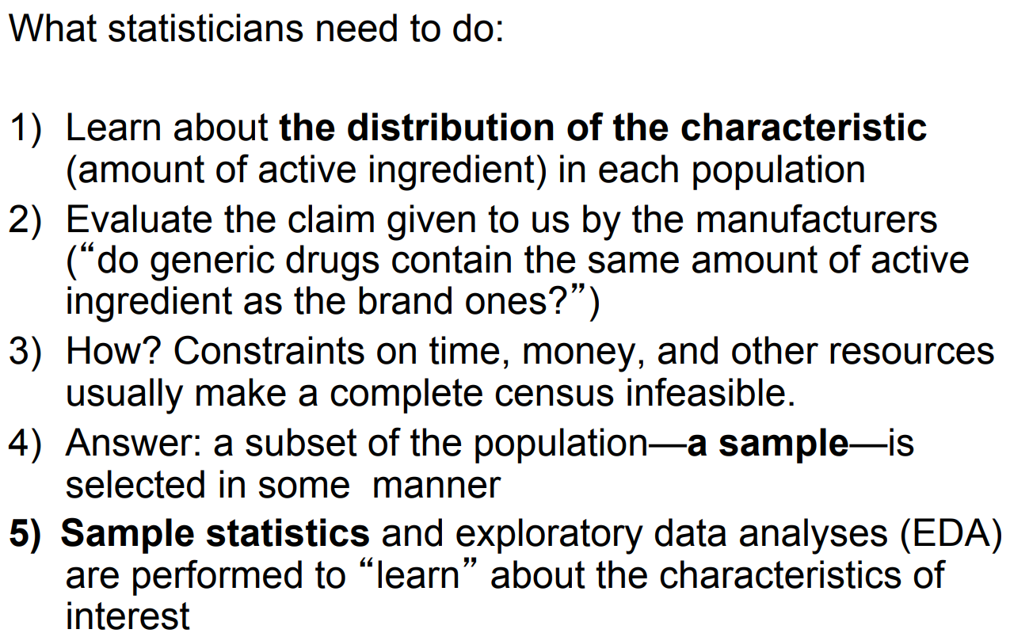
Populations, Samples, Variables and Data

Slide 8
Variables and Data
A variable is a characteristic that changes or varies over time and/or for different individuals or objects under consideration.
Examples:
  Body temperature is variable over time or (and) from person to person.
  Hair color, white blood cell count, time to failure of a computer component.

Slide 9
Definitions
An experimental unit is the individual or object on which a variable is measured.
A measurement results when a variable is actually measured on an experimental unit.
A set of measurements, called data, can be either a sample or a population.

Slide 10
Basic Concept
Population: the set of all measurements of interest to the investigator
Sample: a subset of measurements selected from the population of interest

Slide 11

Example
Variable
  Ethnic group
Experimental unit
  Person
Typical Measurements
  Dayak, Jawa, Melayu, Bali, etc.

Slide 12
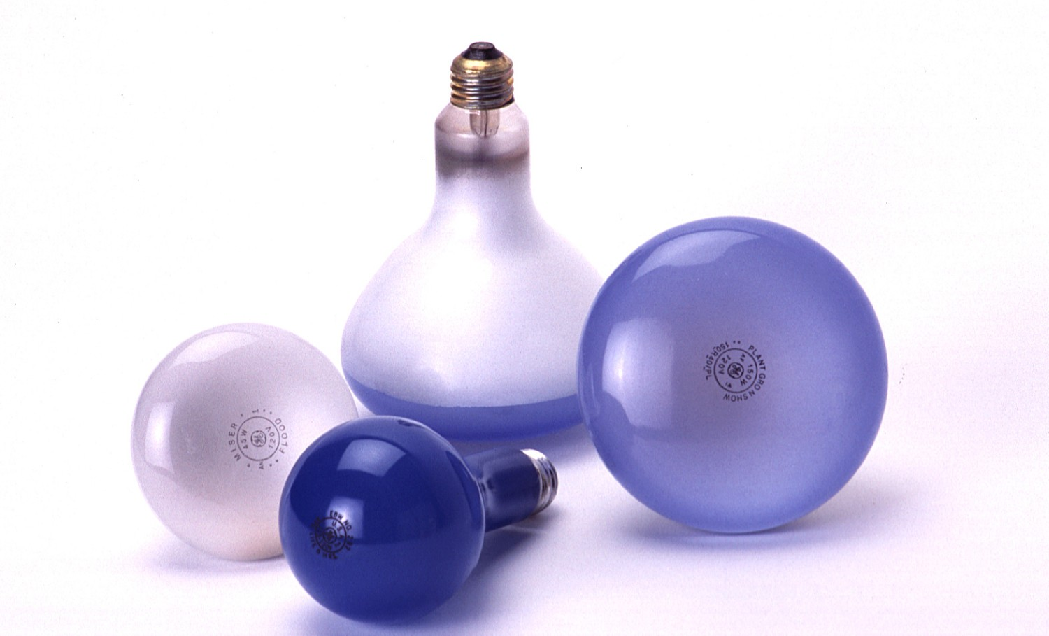
Example
Variable
  Time until a
  light bulb burns out
Experimental unit
  Light bulb
Typical Measurements
  1500 hours, 1535.5 hours, etc.

Slide 13
How many variables have you measured?
Univariate data: One variable is measured on a single experimental unit.
Bivariate data: Two variables are measured on a single experimental unit.
Multivariate data: More than two variables are measured on a single experimental unit.

Slide 14
How many variables have you measured?
Student ID | GPA | Gender | Semester | Major | # of units
1 | 2.0 | F | 5 | Psy | 16
2 | 2.3 | F | 7 | Math | 15
3 | 2.9 | M | 7 | Eng | 17
4 | 2.7 | M | 5 | Eng | 15
5 | 2.6 | F | 3 | Bus | 14

Slide 15
Types of Variables
Qualitative
Quantitative
Discrete
Continuous

Slide 16
Types of Variables
Qualitative variables measure a quality or characteristic on each experimental unit. (Categorical Data)
Examples:
  Ethnic group (dayak, jawa, melayu …)
  Make of car (Toyota, Honda, Ford…)
  Gender (male, female)
  Birthplace (Surabaya, Denpasar,….)

Slide 17
Types of Variables
Quantitative variables measure a numerical quantity on each experimental unit.
  Discrete if it can assume only a finite or countable number of values.
  Continuous if it can assume the infinitely many values corresponding to the points on a line interval.

Slide 18
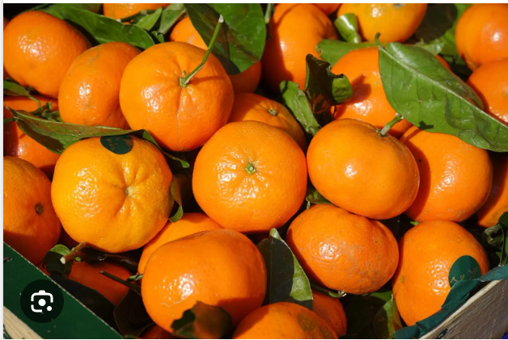
Examples
For each orange tree in a grove, the number of oranges is measured.
  Quantitative discrete
For a particular day, the number of cars entering a college campus is measured.
  Quantitative discrete
Time until a light bulb burns out
  Quantitative continuous

Slide 19
Descriptive Statistics

Slide 20
Graphing Qualitative Variables
Use a data distribution to describe:
  What values of the variable have been measured
  How often each value has occurred
“How often” can be measured 3 ways:
  Frequency in each category
  Relative frequency = Frequency/n
  (proportion in each category)
  Percent = 100 x Relative frequency

Slide 21
Example
A bag of M&M®s contains 25 candies:
Raw Data:
Statistical Table:
m
m
m
m
m
m
m
m
m
m
m
m
m
m
m
m
m
m
m
m
m
m
m
m
m
Color | Tally | Frequency | Relative Frequency | Percent
Red |  | 5 | 5/25 = .20 | 20%
Blue |  | 3 | 3/25 = .12 | 12%
Green |  | 2 | 2/25 = .08 | 8%
Orange |  | 3 | 3/25 = .12 | 12%
Brown |  | 8 | 8/25 = .32 | 32%
Yellow |  | 4 | 4/25 = .16 | 16%
m
m
m
m
m
m
m
m
m
m
m
m
m
m
m
m
m
m
m
m
m
m
m
m
m

Slide 22
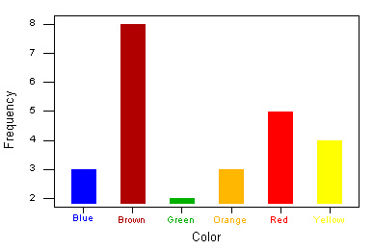
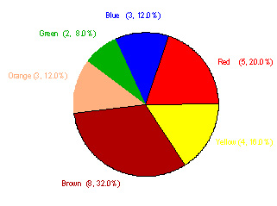
Graphs
Bar Chart:
How often a particular category was observed
Pie Chart:
How the measurements are distributed among the categories

Slide 23
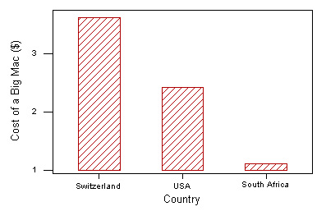
Graphing Quantitative Variables
A single quantitative variable measured for different population segments or for different categories of classification can be graphed using a pie or bar chart.
A Big Mac hamburger costs $3.64 in Switzerland, $2.44 in the U.S. and $1.10 in South Africa.

Slide 24
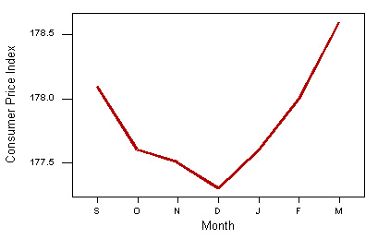
A single quantitative variable measured over time is called a time series. It can be graphed using a line or bar chart.
CPI: All Urban Consumers-Seasonally Adjusted
September | October | November | December | January | February | March
178.10 | 177.60 | 177.50 | 177.30 | 177.60 | 178.00 | 178.60
BUREAU OF LABOR STATISTICS

Slide 25
Dotplots
The simplest graph for quantitative data
Plots the measurements as points on a horizontal axis, stacking the points that duplicate existing points.
Example: The set 4, 5, 5, 7, 6
4 5 6 7

Slide 26
Stem and Leaf Plots
A simple graph for quantitative data
Uses the actual numerical values of each data point.
  Divide each measurement into two parts: the stem and the leaf.
  List the stems in a column, with a vertical line to their right.
  For each measurement, record the leaf portion in the same row as its matching stem.
  Order the leaves from lowest to highest in each stem.
  Provide a key to your coding.

Slide 27
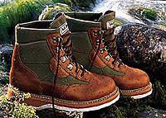
Example
The prices ($) of 18 brands of walking shoes:
90 70 70 70 75 70 65 68 60
74 70 95 75 70 68 65 40 65
4 0
5
6 5 8 0 8 5 5
7 0 0 0 5 0 4 0 5 0
8
9 0 5
4 0
5
6 0 5 5 5 8 8
7 0 0 0 0 0 0 4 5 5
8
9 0 5
Reorder

Slide 28
Interpreting Graphs:
Location and Spread
Check the horizontal and vertical scales
Examine the location of the data distribution
Examine the shape of the distribution
Look for any unusual measurements or outliers

Slide 29
Interpreting Graphs:
Location and Spread
Where is the data centered on the horizontal axis, and how does it spread out from the center?

Slide 30
Interpreting Graphs: Shapes
Mound shaped and symmetric (mirror images)
Skewed right: a few unusually large measurements
Skewed left: a few unusually small measurements
Bimodal: two local peaks

Slide 31
Interpreting Graphs: Outliers
No Outliers
Outlier
Are there any strange or unusual measurements that stand out in the data set?

Slide 32


Example
A quality control process measures the diameter of a gear being made by a machine (cm). The technician records 15 diameters, but inadvertently makes a typing mistake on the second entry.
1.991 1.891 1.991 1.988 1.993 1.989 1.990 1.988
1.988 1.993 1.991 1.989 1.989 1.993 1.990 1.994

Slide 33
Relative Frequency Histograms
A relative frequency histogram for a quantitative data set is a bar graph in which the height of the bar shows “how often” (measured as a proportion or relative frequency) measurements fall in a particular class or subinterval.
Create intervals
Stack and draw bars

Slide 34
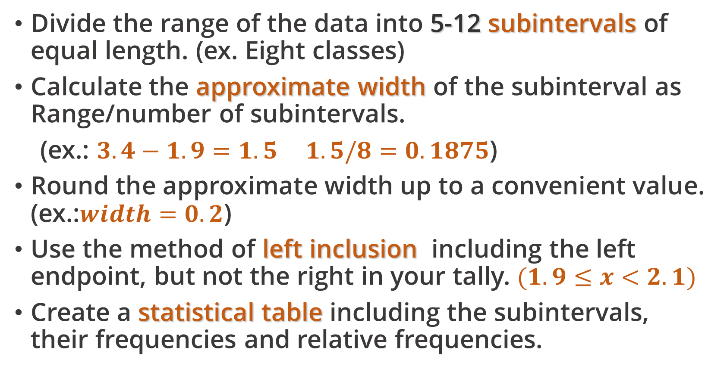
Relative Frequency Histograms
Divide the range of the data into 5-12 subintervals of equal length. (ex. Eight classes)
Calculate the approximate width of the subinterval as Range/number of subintervals.
(ex.: $3.4−1.9=1.5 1.5/8=0.1875$)
Round the approximate width up to a convenient value. (ex.:$width=0.2$)
Use the method of left inclusion, including the left endpoint, but not the right in your tally. $(1.9≤x<2.1)$
Create a statistical table including the subintervals, their frequencies and relative frequencies.

Slide 35
Relative Frequency Histograms
Draw the relative frequency histogram, plotting the subintervals on the horizontal axis and the relative frequencies on the vertical axis.
The height of the bar represents
  The proportion of measurements falling in that class or subinterval.
  The probability that a single measurement, drawn at random from the set, will belong to that class or subinterval.

Slide 36

Example
The ages of 50 tenured faculty at a
state university.
34 48 70 63 52 52 35 50 37 43 53 43 52 44
42 31 36 48 43 26 58 62 49 34 48 53 39 45
34 59 34 66 40 59 36 41 35 36 62 34 38 28
43 50 30 43 32 44 58 53
We choose to use 6 intervals.
Minimum class width = (70 – 26)/6 = 7.33
Convenient class width = 8
Use 6 classes of length 8, starting at 25.

Slide 37
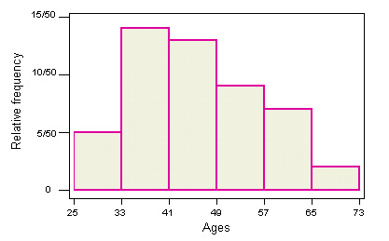
Age | Tally | Frequency | Relative Frequency | Percent
25 to < 33 | 1111 | 5 | 5/50 = .10 | 10%
33 to < 41 | 1111 1111 1111 | 14 | 14/50 = .28 | 28%
41 to < 49 | 1111 1111 111 | 13 | 13/50 = .26 | 26%
49 to < 57 | 1111 1111 | 9 | 9/50 = .18 | 18%
57 to < 65 | 1111 11 | 7 | 7/50 = .14 | 14%
65 to < 73 | 11 | 2 | 2/50 = .04 | 4%

Slide 38
Describing the Distribution
Shape?
Outliers?
What proportion of the tenured faculty are younger than 41?
What is the probability that a randomly selected faculty member is 49 or older?
Skewed right
No.
(14 + 5)/50 = 19/50 = .38
(8 + 7 + 2)/50 = 17/50 = .34

Slide 39
Measures of Location

Slide 40
Measures of Center
A measure along the horizontal axis of the data distribution that locates the center of the distribution.

Slide 41
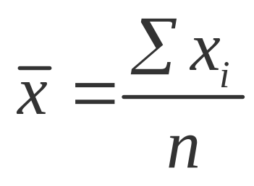
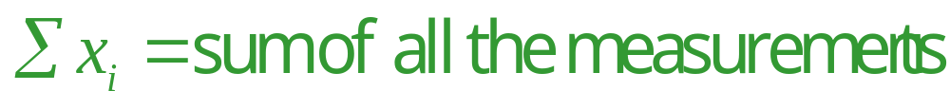
Arithmetic Mean or Average
The mean of a set of measurements is the sum of the measurements divided by the total number of measurements.
where n = number of measurements

Slide 42
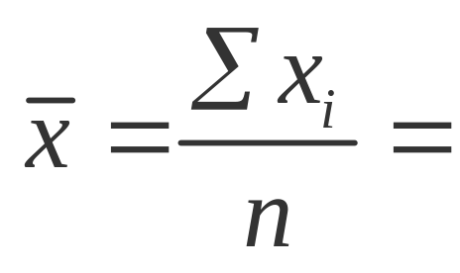
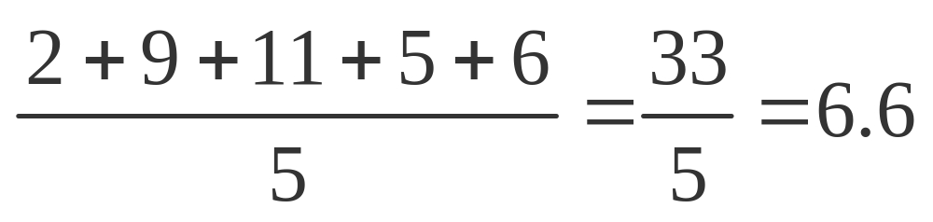
Example
The set: 2, 9, 11, 5, 6
If we were able to enumerate the whole population, the population mean would be called μ (the Greek letter “mu”).

Slide 43
Median
The median of a set of measurements is the middle measurement when the measurements are ranked from smallest to largest.
The position of the median is
.5(n + 1)
  once the measurements have been ordered.

Slide 44
Example
The set: 2, 4, 9, 8, 6, 5, 3 n = 7
Sort: 2, 3, 4, 5, 6, 8, 9
Position: .5(n + 1) = .5(7 + 1) = 4th
Median = 4th largest measurement
The set: 2, 4, 9, 8, 6, 5 n = 6
Sort: 2, 4, 5, 6, 8, 9
Position: .5(n + 1) = .5(6 + 1) = 3.5th
Median = (5 + 6)/2 = 5.5 — average of the 3rd and 4th measurements

Slide 45
Mode
The mode is the measurement which occurs most frequently.
The set: 2, 4, 9, 8, 8, 5, 3
  The mode is 8, which occurs twice
The set: 2, 2, 9, 8, 8, 5, 3
  There are two modes—8 and 2 (bimodal)
The set: 2, 4, 9, 8, 5, 3
  There is no mode (each value is unique).

Slide 46
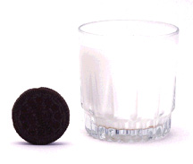
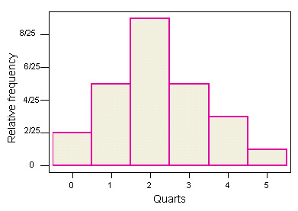
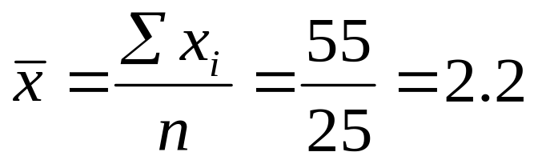


Example
The number of quarts of milk purchased by 25 households:
0 0 1 1 1 1 1 2 2 2 2 2 2 2 2 2 3 3 3 3 3 4 4 4 5
Mean?
Median?
Mode? (Highest peak)

Slide 47
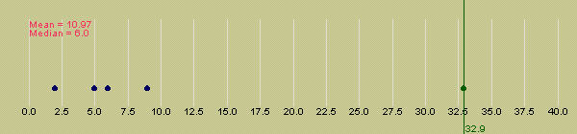
Extreme Values
The mean is more easily affected by extremely large or small values than the median.
The median is often used as a measure of center when the distribution is skewed.

Slide 48
Extreme Values
Symmetric: Mean = Median
Skewed right: Mean > Median
Skewed left: Mean < Median

Slide 49
Measures of Variability

Slide 50
Measures of Variability
A measure along the horizontal axis of the data distribution that describes the spread of the distribution from the center.

Slide 51

The Range
The range, R, of a set of n measurements is the difference between the largest and smallest measurements.
Example: A botanist records the number of petals on 5 flowers:
5, 12, 6, 8, 14
The range is
R = 14 – 5 = 9.
Quick and easy, but only uses 2 of the 5 measurements.

Slide 52

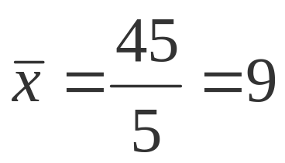
The Variance
The variance is measure of variability that uses all the measurements. It measures the average deviation of the measurements about their mean.
Flower petals: 5, 12, 6, 8, 14
4 6 8 10 12 14

Slide 53
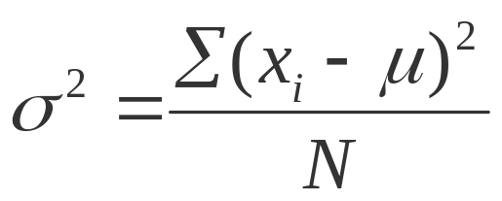
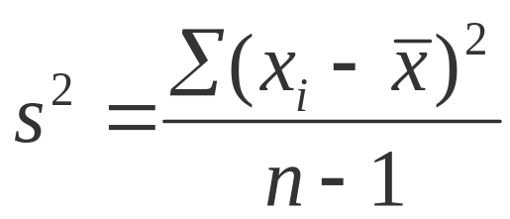
The Variance
The variance of a population of N measurements is the average of the squared deviations of the measurements about their mean μ.
The variance of a sample of n measurements is the sum of the squared deviations of the measurements about their mean, divided by (n – 1).

Slide 54
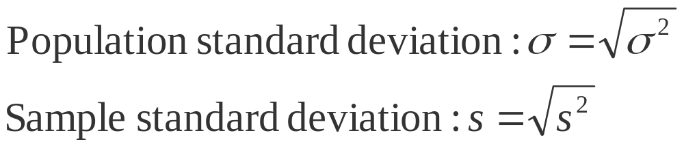
The Standard Deviation
In calculating the variance, we squared all of the deviations, and in doing so changed the scale of the measurements.
(inch-> square inch)
To return this measure of variability to the original units of measure, we calculate the standard deviation, the positive square root of the variance.

Slide 55

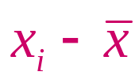
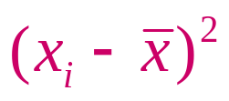
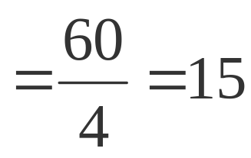
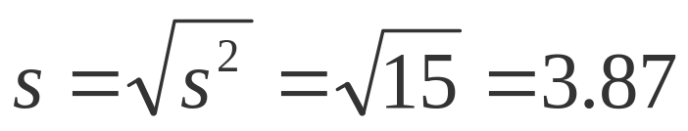
Two Ways to Calculate the Sample Variance
Use the Definition Formula:
 | 5 | -4 | 16
 | 12 | 3 | 9
 | 6 | -3 | 9
 | 8 | -1 | 1
 | 14 | 5 | 25
Sum | 45 | 0 | 60

Slide 56

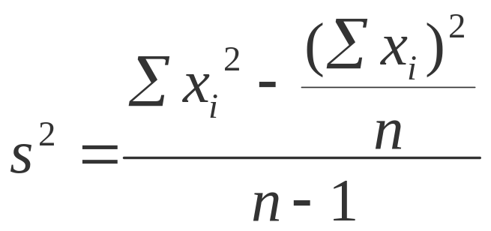
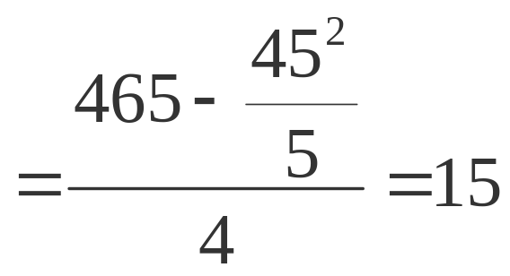
Two Ways to Calculate the Sample Variance
Use the Calculational Formula:
 | 5 | 25
 | 12 | 144
 | 6 | 36
 | 8 | 64
 | 14 | 196
Sum | 45 | 465

Slide 57
Some Notes
The value of s is ALWAYS positive.
The larger the value of s² or s, the larger the variability of the data set.
Why divide by n –1?
  The sample standard deviation s is often used to estimate the population standard deviation σ. Dividing by n –1 gives us a better estimate of σ.

Slide 58

Using Measures of Center and Spread: Tchebysheff’s Theorem
Given a number k greater than or equal to 1 and a set of n measurements, at least 1-(1/k²) of the measurement will lie within k standard deviations of the mean.
Can be used to describe either samples ( and s) or a population (μ and σ).
Important results:
  If k = 2, at least 1 – 1/2² = 3/4 of the measurements are within 2 standard deviations of the mean.
  If k = 3, at least 1 – 1/3² = 8/9 of the measurements are within 3 standard deviations of the mean.

Slide 59
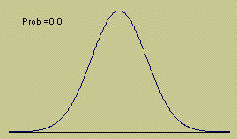
Using Measures of
Center and Spread:
The Empirical Rule
Given a distribution of measurements
that is approximately mound-shaped:
The interval μ ± σ contains approximately 68% of the measurements.
The interval μ ± 2σ contains approximately 95% of the measurements.
The interval μ ± 3σ contains approximately 99.7% of the measurements.

Slide 60
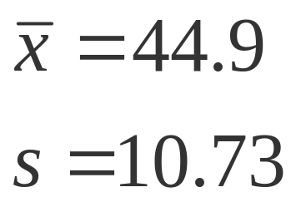
Example
The ages of 50 tenured faculty at a
state university.
34 48 70 63 52 52 35 50 37 43 53 43 52 44
42 31 36 48 43 26 58 62 49 34 48 53 39 45
34 59 34 66 40 59 36 41 35 36 62 34 38 28
43 50 30 43 32 44 58 53
Shape?
Skewed right

Slide 61

k | ±ks | Interval | Proportion in Interval | Tchebysheff | Empirical Rule
1 | 44.9 ±10.73 | 34.17 to 55.63 | 31/50 (.62) | At least 0 | ≈ .68
2 | 44.9 ±21.46 | 23.44 to 66.36 | 49/50 (.98) | At least .75 | ≈ .95
3 | 44.9 ±32.19 | 12.71 to 77.09 | 50/50 (1.00) | At least .89 | ≈ .997
Yes. Tchebysheff’s Theorem must be true for any data set.
Do the actual proportions in the three intervals agree with those given by Tchebysheff’s Theorem?
Do they agree with the Empirical Rule?
Why or why not?
No. Not very well.
The data distribution is not very mound-shaped, but skewed right.

Slide 62
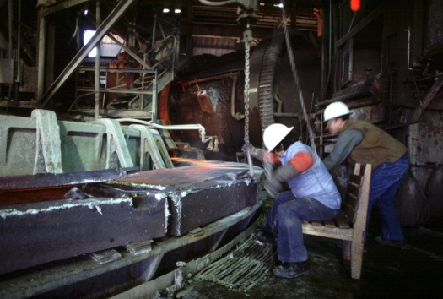
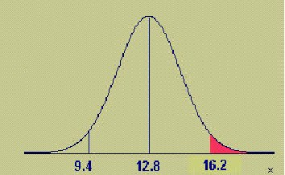
Example
The length of time for a worker to complete a specified operation averages 12.8 minutes with a standard deviation of 1.7 minutes. If the distribution of times is approximately mound-shaped, what proportion of workers will take longer than 16.2 minutes to complete the task?
95% between 9.4 and 16.2
47.5% between 12.8 and 16.2
.475
.475
.025
(50-47.5)% = 2.5% above 16.2

Slide 63
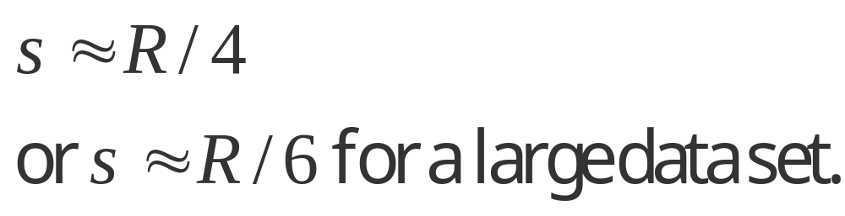
Approximating s
From Tchebysheff’s Theorem and the Empirical Rule, we know that
  R ≈ 4-6 s
To approximate the standard deviation of a set of measurements, we can use:

Slide 64
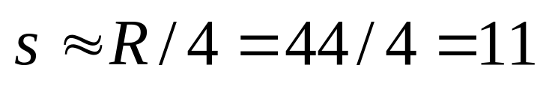
Approximating s
The ages of 50 tenured faculty at a
state university.
34 48 70 63 52 52 35 50 37 43 53 43 52 44
42 31 36 48 43 26 58 62 49 34 48 53 39 45
34 59 34 66 40 59 36 41 35 36 62 34 38 28
43 50 30 43 32 44 58 53
R = 70 – 26 = 44
Actual s = 10.73

Slide 65
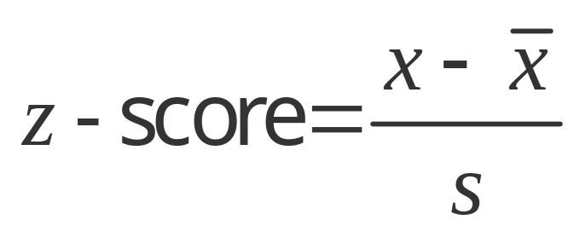


Measures of Relative Standing
Where does one particular measurement stand in relation to the other measurements in the data set?
How many standard deviations away from the mean does the measurement lie? This is measured by the z-score.
Suppose s = 2.
s
4
s
s
x = 9 lies z =2 std dev from the mean.

Slide 66
z-Scores
From Tchebysheff’s Theorem and the Empirical Rule
  At least 3/4 and more likely 95% of measurements lie within 2 standard deviations of the mean.
  At least 8/9 and more likely 99.7% of measurements lie within 3 standard deviations of the mean.
z-scores between –2 and 2 are not unusual. z-scores should not be more than 3 in absolute value. z-scores larger than 3 in absolute value would indicate a possible outlier.
Outlier
Not unusual
Outlier
z
-3 -2 -1 0 1 2 3
Somewhat unusual

Slide 67
Measures of Relative Standing
How many measurements lie below the measurement of interest? This is measured by the p^{th} percentile.
p %
(100-p) %
x
p-th percentile

Slide 68
Examples
90% of all men (16 and older) earn more than $319 per week.
BUREAU OF LABOR STATISTICS 2002
10%
90%
$319 is the 10th percentile.
$319
50th Percentile
25th Percentile
75th Percentile
≡ Median
≡ Lower Quartile (Q₁₎
≡ Upper Quartile (Q₃)

Slide 69
Quartiles and the IQR
The lower quartile (Q₁) is the value of x which is larger than 25% and less than 75% of the ordered measurements.
The upper quartile (Q₃) is the value of x which is larger than 75% and less than 25% of the ordered measurements.
The range of the “middle 50%” of the measurements is the interquartile range,
IQR = Q₃ – Q₁

Slide 70
Calculating Sample Quartiles
The lower and upper quartiles (Q₁ and Q₃), can be calculated as follows:
The position of Q₁ is
.25(n + 1)
The position of Q₃ is
.75(n + 1)
once the measurements have been ordered. If the positions are not integers, find the quartiles by interpolation.

Slide 71
Example
The prices ($) of 18 brands of walking shoes:
60 65 65 65 68 68 70 70
70 70 70 70 74 75 75 90 95
Position of Q₁ = .25(18 + 1) = 4.75
Position of Q₃ = .75(18 + 1) = 14.25
Q₁is 3/4 of the way between the 4th and 5th ordered measurements, or
  Q₁ = 65 + .75(65 - 65) = 65.

Slide 72
Example
The prices ($) of 18 brands of walking shoes:
60 65 65 65 68 68 70 70
70 70 70 70 74 75 75 90 95
Position of Q₁ = .25(18 + 1) = 4.75
Position of Q₃ = .75(18 + 1) = 14.25
Q₃ is 1/4 of the way between the 14th and 15th ordered measurements, or
  Q₃ = 75 + .25(75 - 74) = 75.25
  and
  IQR = Q₃ – Q₁ = 75.25 - 65 = 10.25

Slide 73
Using Measures of Center and Spread: The Box Plot
The Five-Number Summary:
Min Q₁ Median Q₃ Max
Divides the data into 4 sets containing an equal number of measurements.
A quick summary of the data distribution.
Use to form a box plot to describe the shape of the distribution and to detect outliers.

Slide 74
Constructing a Box Plot
Calculate Q₁, the median, Q₃ and IQR.
Draw a horizontal line to represent the scale of measurement.
Draw a box using Q₁, the median, Q₃.
Q₁
m
Q₃

Slide 75
Constructing a Box Plot
Isolate outliers by calculating
  Lower fence: Q₁-1.5 IQR
  Upper fence: Q₃+1.5 IQR
Measurements beyond the upper or lower fence is are outliers and are marked (*).
*
Q₁
m
Q₃

Slide 76
Constructing a Box Plot
Draw “whiskers” connecting the largest and smallest measurements that are NOT outliers to the box.
*
Q₁
m
Q₃

Slide 77
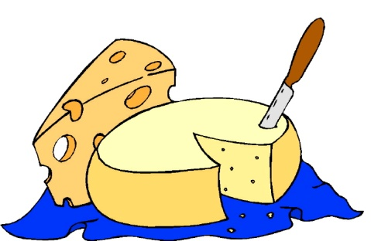
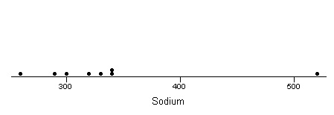
Example
Amt of sodium in 8 brands of cheese:
260 290 300 320 330 340 340 520
Q₁ = 292.5
m = 325
Q₃ = 340
m
Q₁
Q₃

Slide 78
Example
IQR = 340-292.5 = 47.5
Lower fence = 292.5-1.5(47.5) = 221.25
Upper fence = 340 + 1.5(47.5) = 411.25
Outlier: x = 520
*
m
Q₁
Q₃

Slide 79
Interpreting Box Plots
Median line in center of box and whiskers of equal length—symmetric distribution
Median line left of center and long right whisker—skewed right
Median line right of center and long left whisker—skewed left

Slide 80
Thank you
Februay 2023

Slide 81
References
Jay L. Devore. (2020). Probability and Statistics for Engineering and the Sciences, 9E. Cancage Learning, Boston USA. ISBN-13: 978-0-538-73352-6

